Slide 1
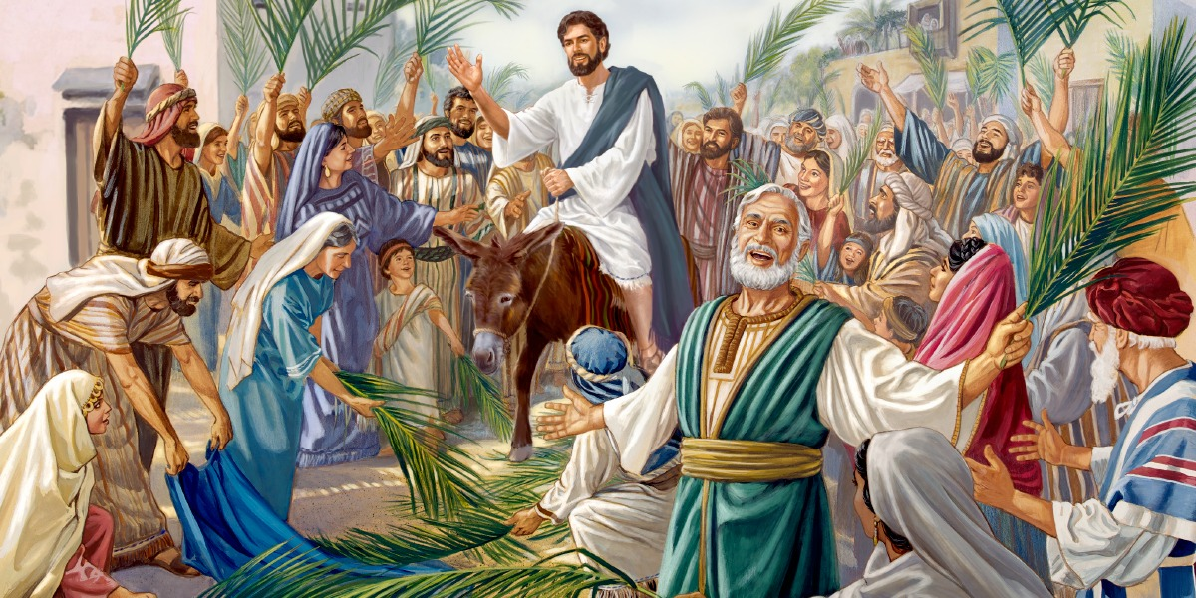

Slide 2
THE TRIUMPHAL ENTRY
I. DISCIPLES SUBMIT TO CHRIST (Luke 19:1-4)
As Jesus and the disciples approached Jerusalem, they came to the town of Bethphage on the Mount of Olives. Jesus sent two of them on ahead.

Slide 3
THE TRIUMPHAL ENTRY
² “Go into the village over there,” he said. “As soon as you enter it, you will see a donkey tied there, with its colt beside it. Untie them and bring them to me.
³ If anyone asks what you are doing, just say, ‘The Lord needs them,’ and he will immediately let you take them.”

Slide 4
THE TRIUMPHAL ENTRY
Rejoice, O people of Zion Shout in triumph, O people of Jerusalem! Look, your king is coming to you. He is righteous and victorious, yet he is humble, riding on a donkey— riding on a donkey’s colt.
Zech. 9:9

Slide 5
THE TRIUMPHAL ENTRY
II. JESUS HUMBLY SUBMITS TO THE WILL OF GOD
Then they brought him to Jesus.
And they threw their own clothes on the colt,
and they set Jesus on him.
Luke 19:35

Slide 6
THE TRIUMPHAL ENTRY
²⁹ Take my yoke upon you.
Let me teach you,
because I am humble and gentle at heart,
and you will find rest for your souls.
³⁰ For my yoke is easy to bear,
and the burden I give you is light.”
Matt. 11:29-30

Slide 7
THE TRIUMPHAL ENTRY
Though Jesus was in the form of God, He did not count equality with God something to be grasped, but made Himself nothing, taking on the form of a servant, being born in the likeness of men . . . He humbled Himself by becoming obedient to the point of death, even death on a cross.
Philippians 2:6-8

Slide 8
THE TRIUMPHAL ENTRY
"The Son of man came not to be served,
but to serve, and to give his life
as a ransom for many."
Matthew 20:28

Slide 9
THE TRIUMPHAL ENTRY
III. FICKLED CROWDS SUBMISSION (Lu. 19:36-38)
36 And as He went, many spread their clothes on the road.
37 Then, as He was now drawing near the descent of the Mount of Olives, the whole multitude of the disciples began to rejoice and praise God with a loud voice for all the mighty works they had seen,

Slide 10
THE TRIUMPHAL ENTRY
³⁸ saying:
“‘Blessed is the King
who comes in the name of the Lord!’
Peace in heaven and glory in the highest!”

Slide 11
THE TRIUMPHAL ENTRY
IV. THE IRRATIONAL PHARASEES (Lu. 11:39-40)
³⁹ And some of the Pharisees called to Him from the crowd, “Teacher, rebuke Your disciples.”
⁴⁰ But He answered and said to them, “I tell you that if these should keep silent, the stones would immediately cry out.”

